Slide 1
COMPUTATIONAL FLUID DYNAMICS TEST-2
-YASHWANT MOHARIL
(111810124)

Slide 2
PROBLEM STATEMENT
Solution to two-dimensional Incompressible Navier-Stokes Equations, on a 2-D Lid-Driven Cavity (steady) Problem with discretization and visualization.
u=2m/s

Slide 3
ASSUMPTIONS
1)Y-velocity is 0 everywhere
2)Flow is in 2-Directions only
3)Flow is steady.
4)X-velocity is 2m/s on the top layer of the cavity
5)No flow through the cavity
6)Unit domain => dx=dy=h<say>

Slide 4
APPROACH
1)Stagger the variables
2)Assume P field
3)Calculate u*,v* from NS equations
4)Corrected pressure and velocities from pressure correction
5)Restore them to the Collocated variables

Slide 5
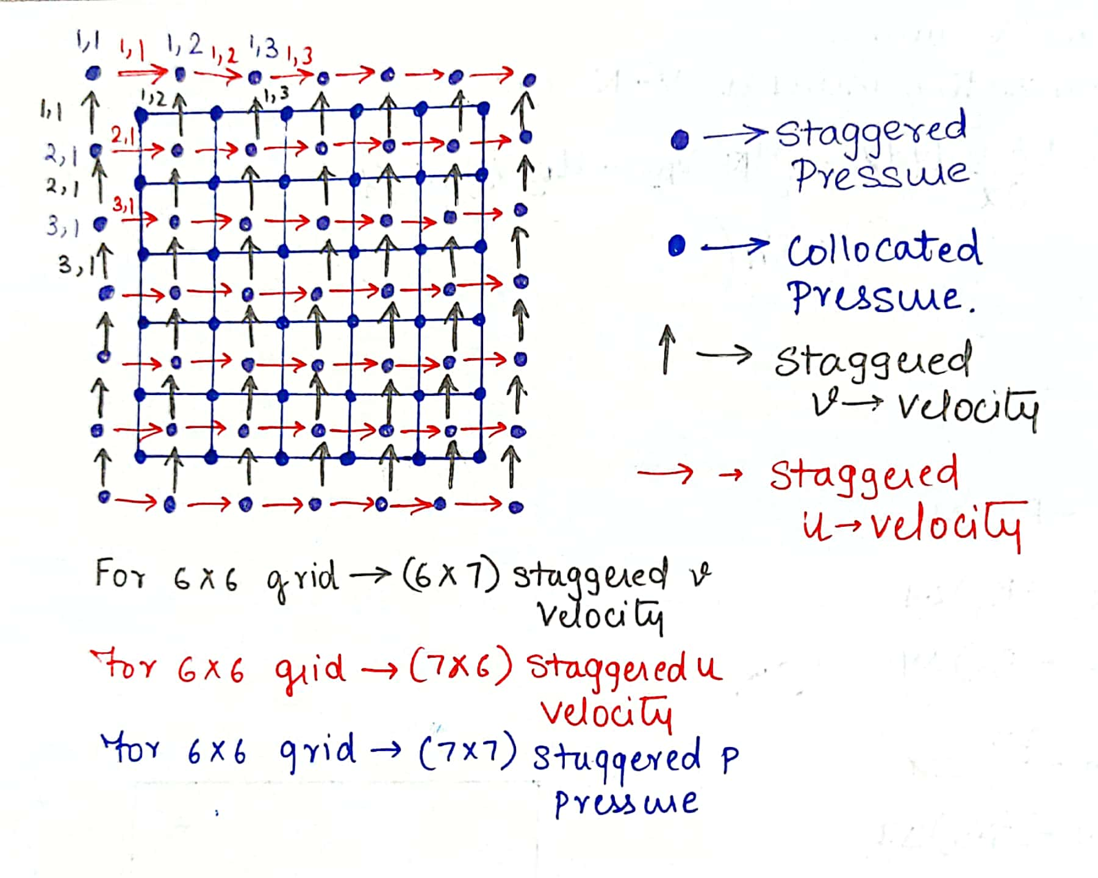
STAGGERD GRID

Slide 6
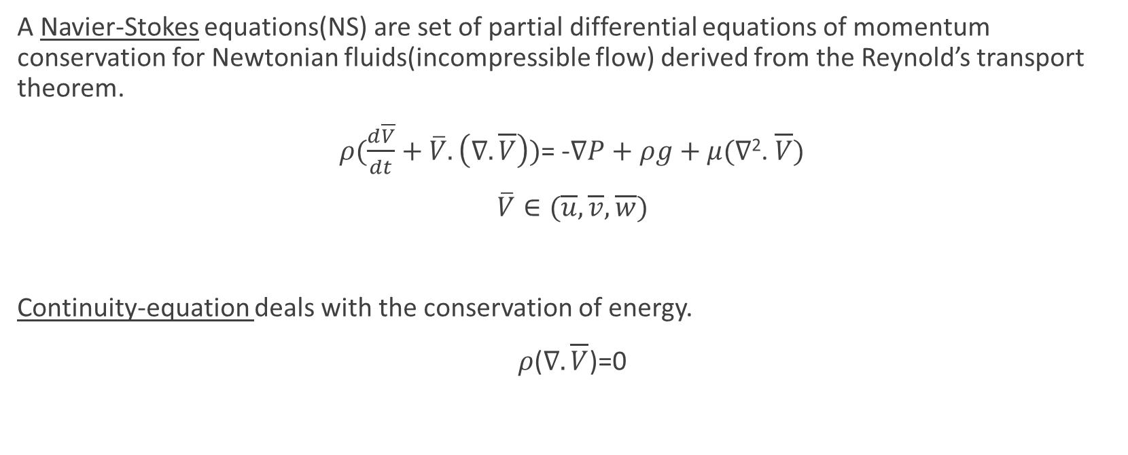
GOVERNING EQUATIONS
A Navier-Stokes equations(NS) are set of partial differential equations of momentum conservation for Newtonian fluids(incompressible flow) derived from the Reynold’s transport theorem.
$ρ(\frac{d\overline{V}}{dt}+\overline{V}.\left(∇.\overline{V}\right))$= -$∇P+ρg+μ(∇\text{2}$. $\overline{V})$
$\overline{V}∈(\overline{u},\overline{v},\overline{w})$
Continuity-equation deals with the conservation of energy.
$ρ$($∇.\overline{V}$)=0

Slide 7
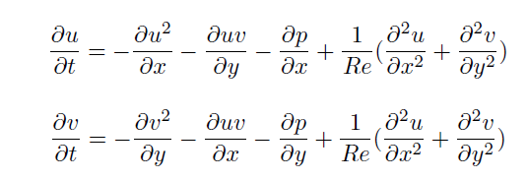

Non dimensionalising the Navier-Stokes equation.
Rewriting the continuity equation.

Slide 8
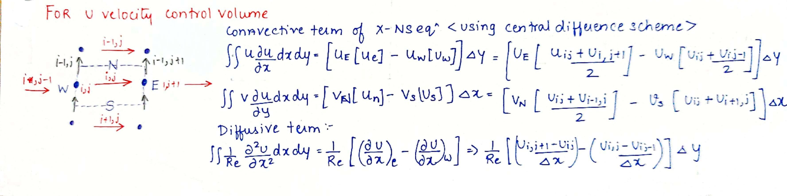
DICRITIZATION(X-VELOCITY)

Slide 9
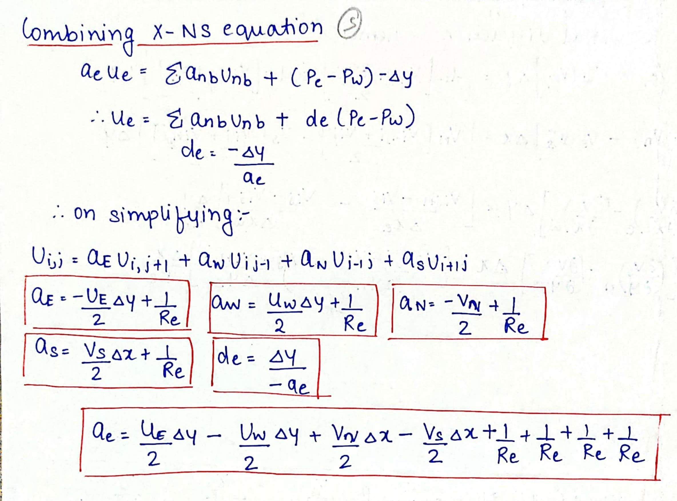
DICRITIZATION(X-VELOCITY)

Slide 10
%MATLAB CODE
for i=2:grid_points;
for j=2:grid_points-1;
uE= ( u(i,j+1) + u(i,j))/2;
uW= ( u(i,j) + u(i,j-1))/2;
vN= ( v(i-1,j) + v(i-1,j+1))/2;
vS= ( v(i,j) + v(i+1,j+1))/2;
a_E= -uE*0.5*h + nu;
a_N= -vN*0.5*h + nu;
a_S= uS*0.5*h + nu;
a_W= uW*0.5*h + nu;
a_e= uE*0.5*h + nu - uW*0.5*h + nu + vN*0.5*h + nu - uS*0.5*h + nu;
de(i,j)=-h/a_e;
u_star(i,j)=(a_N*T(i-1,j)+a_S*T(i+1,j)+a_W*T(i,j-1)+a_E*T(i,j+1))/a_e -
de(i,j)*(p(i,j+1)-p(i,j));
end
end

Slide 11
//python code
for i in range(1,grid_points):
for j in range(1,grid_points-1):
uE = 0.5*(u[i][j] + u[i][j+1])
uW = 0.5*(u[i][j] + u[i][j-1])
vN = 0.5*(v[i-1][j] + v[i-1][j+1])
vS = 0.5*(v[i][j] + v[i][j+1])
aE = -0.5*uE*h + nu
aW = 0.5*uW*h + nu
aN = -0.5*vN*h + nu
aS = 0.5*vS*h + nu
ae = 0.5*uE*h - 0.5*uW*h + 0.5*vN*h - 0.5*vS*h + 4*nu
de[i][j] = -h/ae
u_star[i][j] = (aE*u[i][j+1] + aW*u[i][j-1] + aN*u[i-1][j] + aS*u[i+1][j]/ae + de[i][j]*(p[i][j+1] - p[i][j]))
//python code

Slide 12
STAGGERD GRID

Slide 13
BOUNDARY CONDITIONS
u_star(imin,:)=4-u(2,:);
u_star(2:imax-1,1)=0;
u(2:imax-1,grid_points)=0;
u_star(imax,:)=-u_star(imax-1,:);

Slide 14
BOUNDARY CONDITIONS
u_star[0,:]=4-u_star[1,:]
u_star[grid_points,:]=-u_star[grid_points-1,:]
u_star[1:grid_points,0]=0
u_star[1:grid_points,grid_points-1]=0

Slide 15
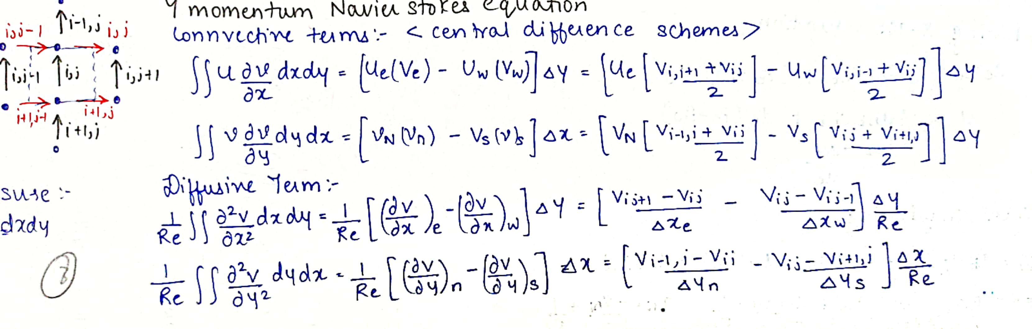
DICRITIZATION(Y-VELOCITY)

Slide 16
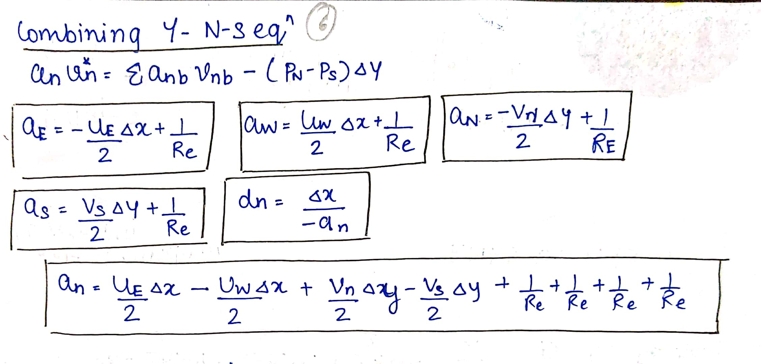
DICRITIZATION(Y-VELOCITY)

Slide 17
%MATLAB CODE
for i=2:grid_points
for j=2:grid_points+1;
uE =0.5*(u(i,j)+u(i+1,j));
uW =0.5*(u(i,j-1)+u(i+1,j-1));
vN =0.5*(v(i-1,j)+v(i,j));
vS =0.5*(v(i,j)+v(i+1,j));
a_E = -0.5*uE*h+nu;
a_W = 0.5*uW*h+nu;
a_N = -0.5*vN*h+nu;
a_S = 0.5*vS*h+nu;
a_n = 0.5*uE*h-0.5*uW*h+0.5*vN*h-0.5*vS*h+4*nu;
dn(i,j)=h/a_n;
v_star(i,j) =(a_E*v(i,j+1)+a_W*v(i,j-1)+a_N*v(i-1,j)+a_S*v(i+1,j))/a_n
- d_n(i,j)*(p(i,j) - p(i+1,j));
end
end

Slide 18
//PYTHON CODE
for i in range(1,grid_points-1):
for j in range(1,grid_points):
uE=0.5*(u[i][j]+u[i+1][j])
uW=0.5*(u[i][j-1]+u[i+1][j-1])
vN=0.5*(v[i-1][j]+v[i][j])
vS=0.5*(v[i][j]+v[i+1][j])
aE=-0.5*uE*h + nu
aW=0.5*uW*h + nu
aN=-0.5*vN*h + nu
aS=0.5*vS*h + nu
an=0.5*uE*h-0.5*uW*h+0.5*vN*h-0.5*vS*h+4*nu
dn[i][j] = -h/an
v_star[i][j] = (aE*v([i][j+1] + aW*v[i][j-1] + aN*v[i-1][j] + aS*v[i+1][j])/an + dn[i][j]*(p[i][j]-p[i+1][j]))

Slide 19
STAGGERD GRID

Slide 20
BOUNDARY CONDITIONS
v_star(1,2:jmax-1)=0;
v_star(imax,2:jmax-1)=0;
v_star(:,1)=-v_star(:,2);
v_star(:,jmax)=-v_star(:,jmax-1);

Slide 21
BOUNDARY CONDITIONS
v_star[:,0]=-v_star[:,1]
v_star[:,grid_points]=-v_star[:,grid_points-1]
v_star[0,1:grid_points]=0
v_star[grid_points-1,1:grid_points]=0

Slide 22
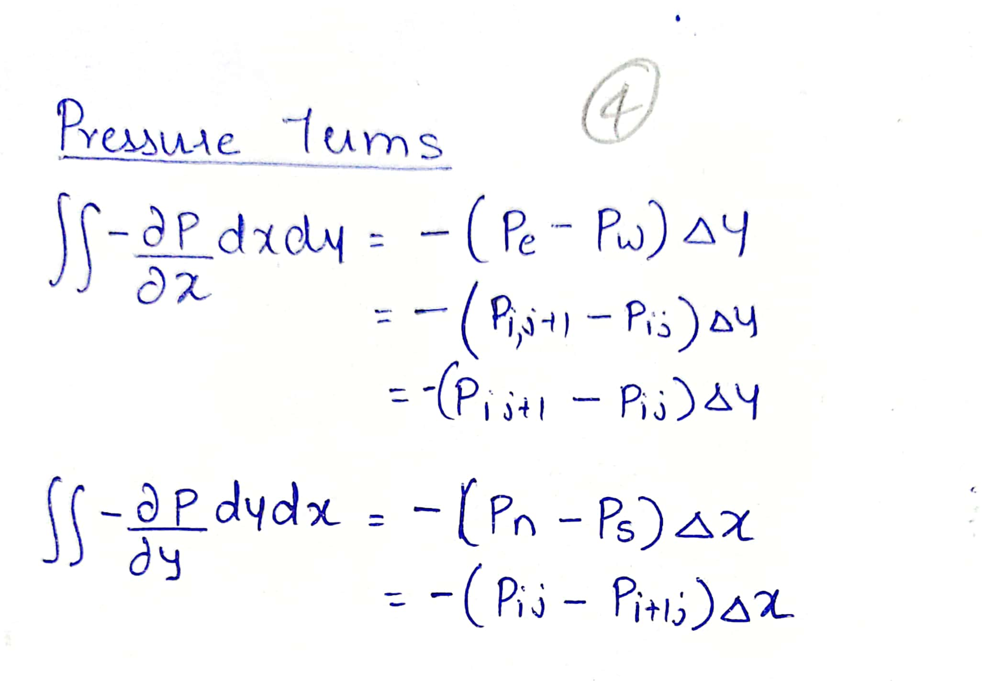
PRESSURE DISCRITIZATION

Slide 23
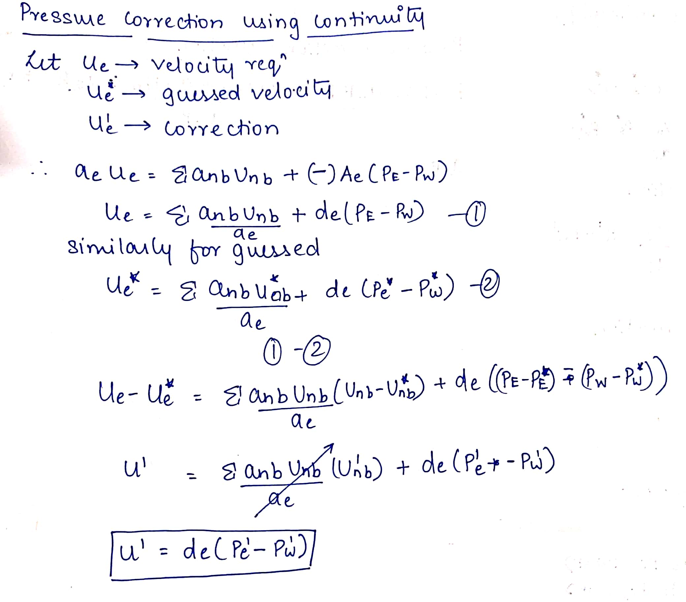
PRESSURE CORRECTION

Slide 24
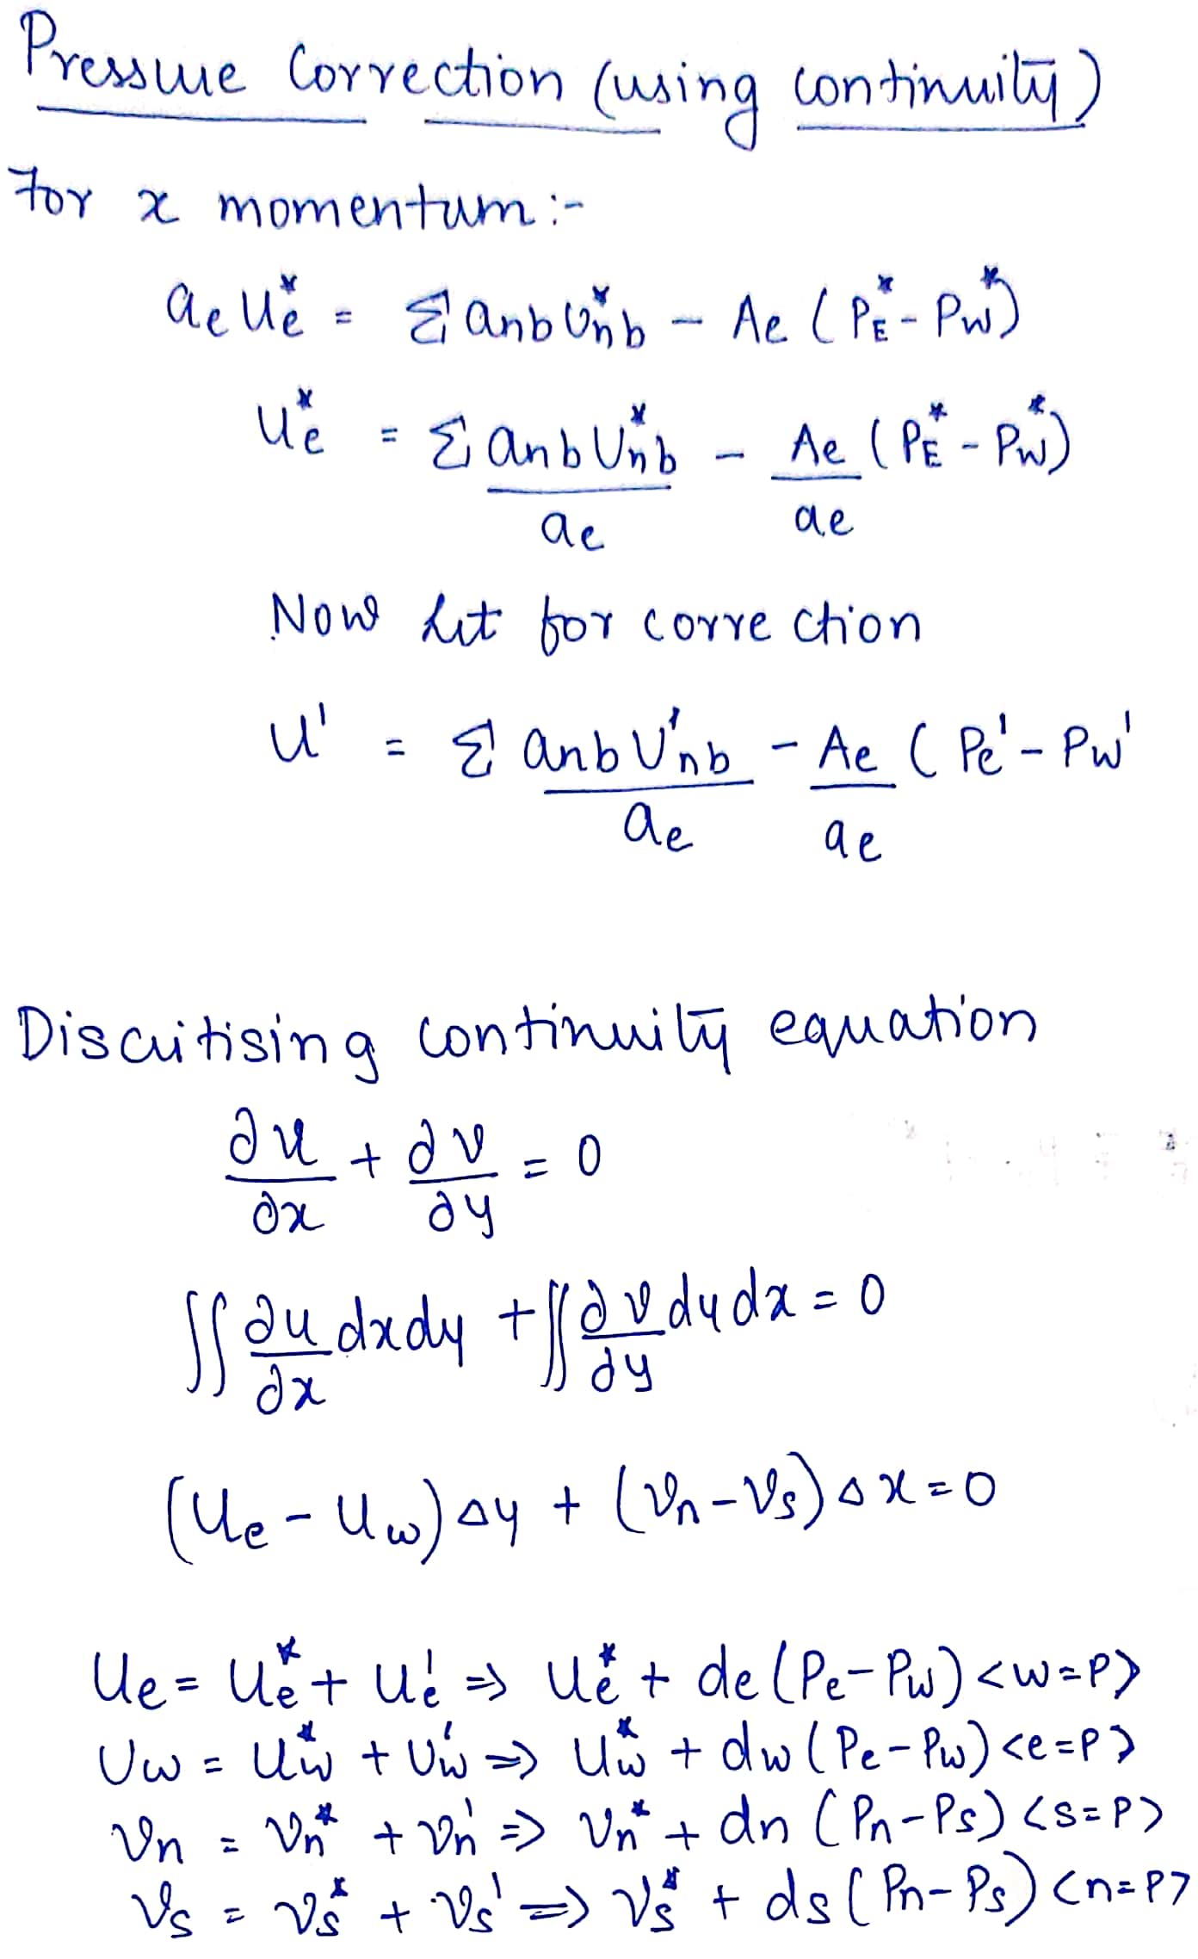
DICRITIZATION(CONTINUITY)

Slide 25
for i=2:grid_points
for j=2:grid_points
a_E =-de(i,j)*h;
a_W =-de(i,j-1)*h;
a_N =-dn(i-1,j)*h;
a_S =-dn(i,j)*h;
a_P =a_E+a_W+a_N+a_S;
b(i,j)=-(u_star(i,j)-u_star(i,j-1))*h+(v_star(i,j)-v_star(i-1,j))*h;
pressure_correction(i,j)=(a_E*pressure_correction(i,j+1)+a_W*pressure_corrextion(i,j-1) +a_N*pressurecorrection(i-1,j)+a_S*pressure_correction(i+1,j)+
b(i,j))/a_P;
end
end

Slide 26
for i in range(1,grid_points):
for j in range(1,grid_points):
aE=-de[i][j]*h;
aW=-de[i][j-1]*h;
aN=-dn[i-1][j]*h;
aS=-dn[i][j]*h;
a_P=aE+aW+aN+aS;
b[i][j] = -(u_star[i][j] - u_star[i][j-1])*h + (v_star[i][j] - v_star[i-1][j])*h;
pressure_ccorrection[i][j]=(aE*pressure_ccorrection[i][j+1]+aW*pressure_ccorrection[i][j-1]+aN*pressure_ccorrection[i-1][j]+aS*pressure_ccorrection[i+1][j]+b[i][j])/a_P

Slide 27
STAGGERD GRID

Slide 28
BOUNDARY CONDITIONS
p_new(1,:)=p_new(2,:);
p_new(imax,:)=p_new(imax-1,:);
p_new(:,1)=p_new(:,2);
p_new(:,jmax)=p_new(:,jmax-1)

Slide 29
BOUNDARY CONDITIONS
p_new[0,:]=p_new[1,:]
p_new[grid_points,:]=p_new[grid_points-1,:]
p_new[:,0]=p_new[:,1]
p_new[:,grid_points]=p_new[:,grid_points-1]

Slide 30
VELOCITY CORRECTIONS
for i=2:grid_points
for j=2:grid_points - 1
u_new(i,j)=u_star(i,j)+d_e(i,j)*(pressure_correction(i,j+1)-
pressure_correction(i,j));
end
end
for i = 2:grid_points-1
for j=2:grid_points
v_new(i,j)=v_star(i,j)+d_n(i,j)*(pressure_correctionc(i,j)-
pressure_correction(i+1,j));
end
end

Slide 31
VELOCITY CORRECTIONS
for i in range(1,grid_points):
for j in range(1,grid_points):
u_new[i][j]=u_star[i][j]+alpha*de[i][j]*(pressure_ccorrection[i][j+1]- pressure_ccorrection[i][j])
for i in range(1,grid_points):
for j in range(1,grid_points):
v_new[i][j]=v_star[i][j]+alpha*dn[i][j]*(pressure_ccorrection[i][j] - pressure_ccorrection[i+1][j])

Slide 32
STAGGERD GRID

Slide 33
COLLOCATED GRIDS
for i in range(grid_points):
for j in range(grid_points):
%phi=(phi_s/ne+phi_s/nw)/2
u_final[i][j]=(u[i][j]+u[i+1][j])/2
v_final[i][j]=(v[i][j]+v[i][j+1])/2
%(p=(Pse+Psw+Pne+Pnw)/4)
p_final[i][j]=(p[i][j]+p[i][j+1]+p[i+1][j]+p[i+1][j+1])/4

Slide 34
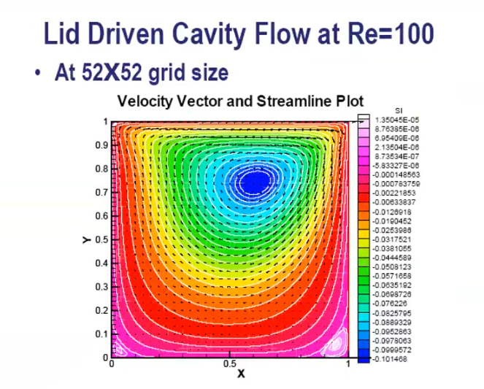
VISUALIZATION
EXPECTED CONTOUR PLOT OF u-VELOCITY(Re=100,52x52)

Slide 35
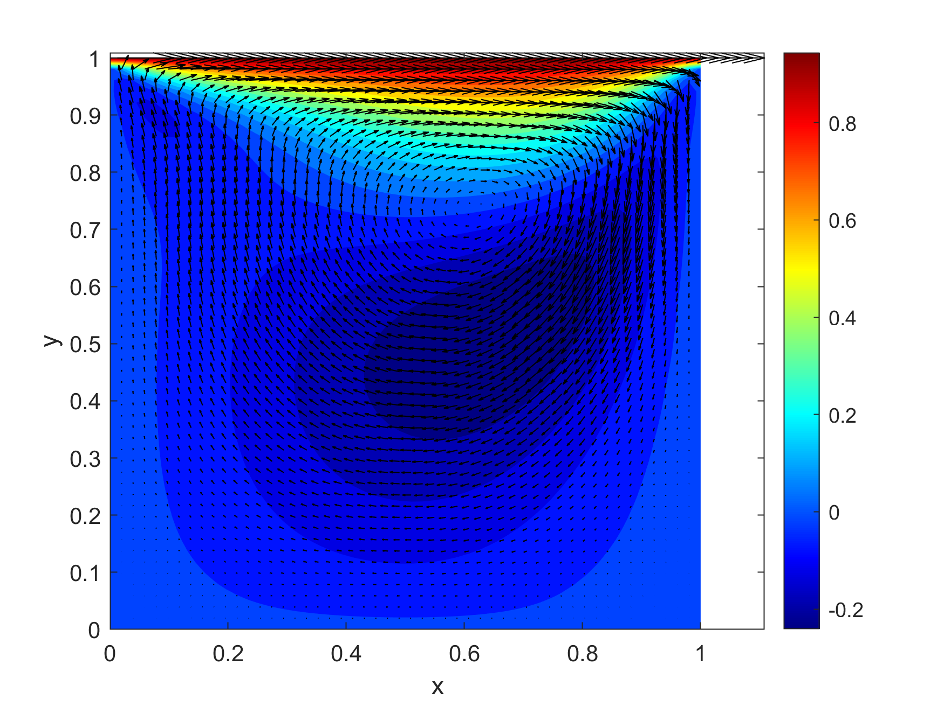
VISUALIZATION
CONTOUR PLOT OF u-VELOCITY(Re=100,52x52)

Slide 36
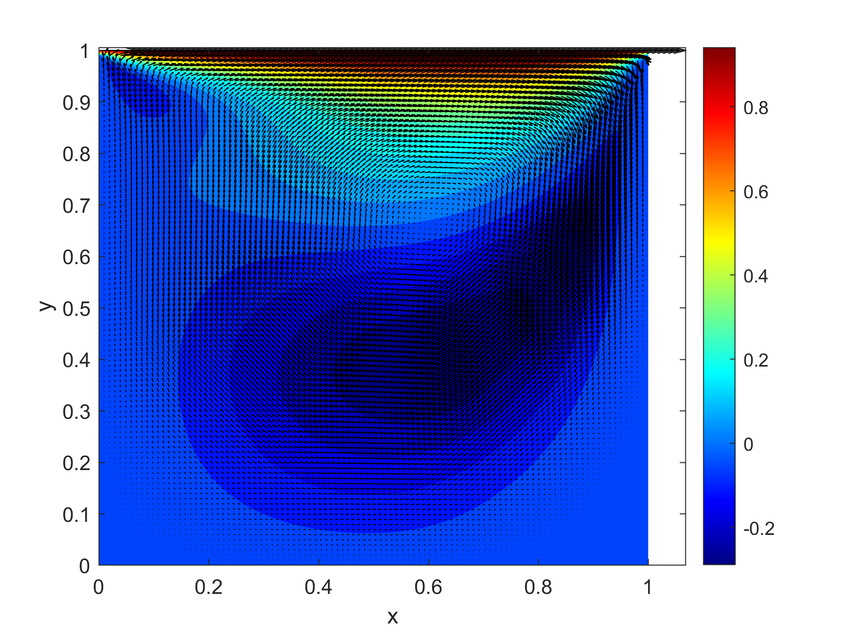
VISUALIZATION
CONTOUR PLOT OF u-VELOCITY(Re=200,102x102)

Slide 37
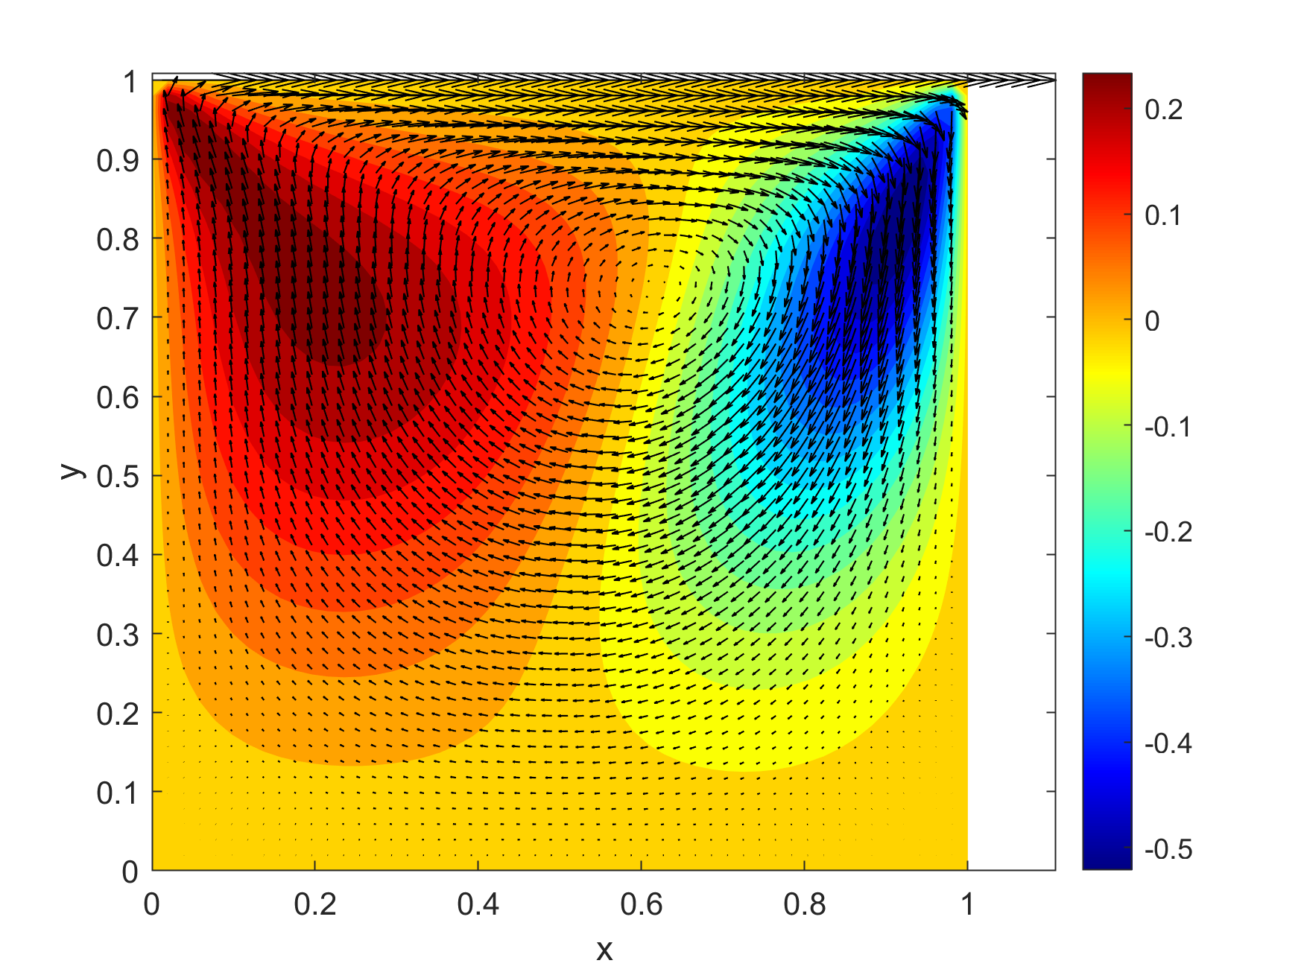
VISUALIZATION
CONTOUR PLOT OF v-VELOCITY(Re=100,52x52)

Slide 38
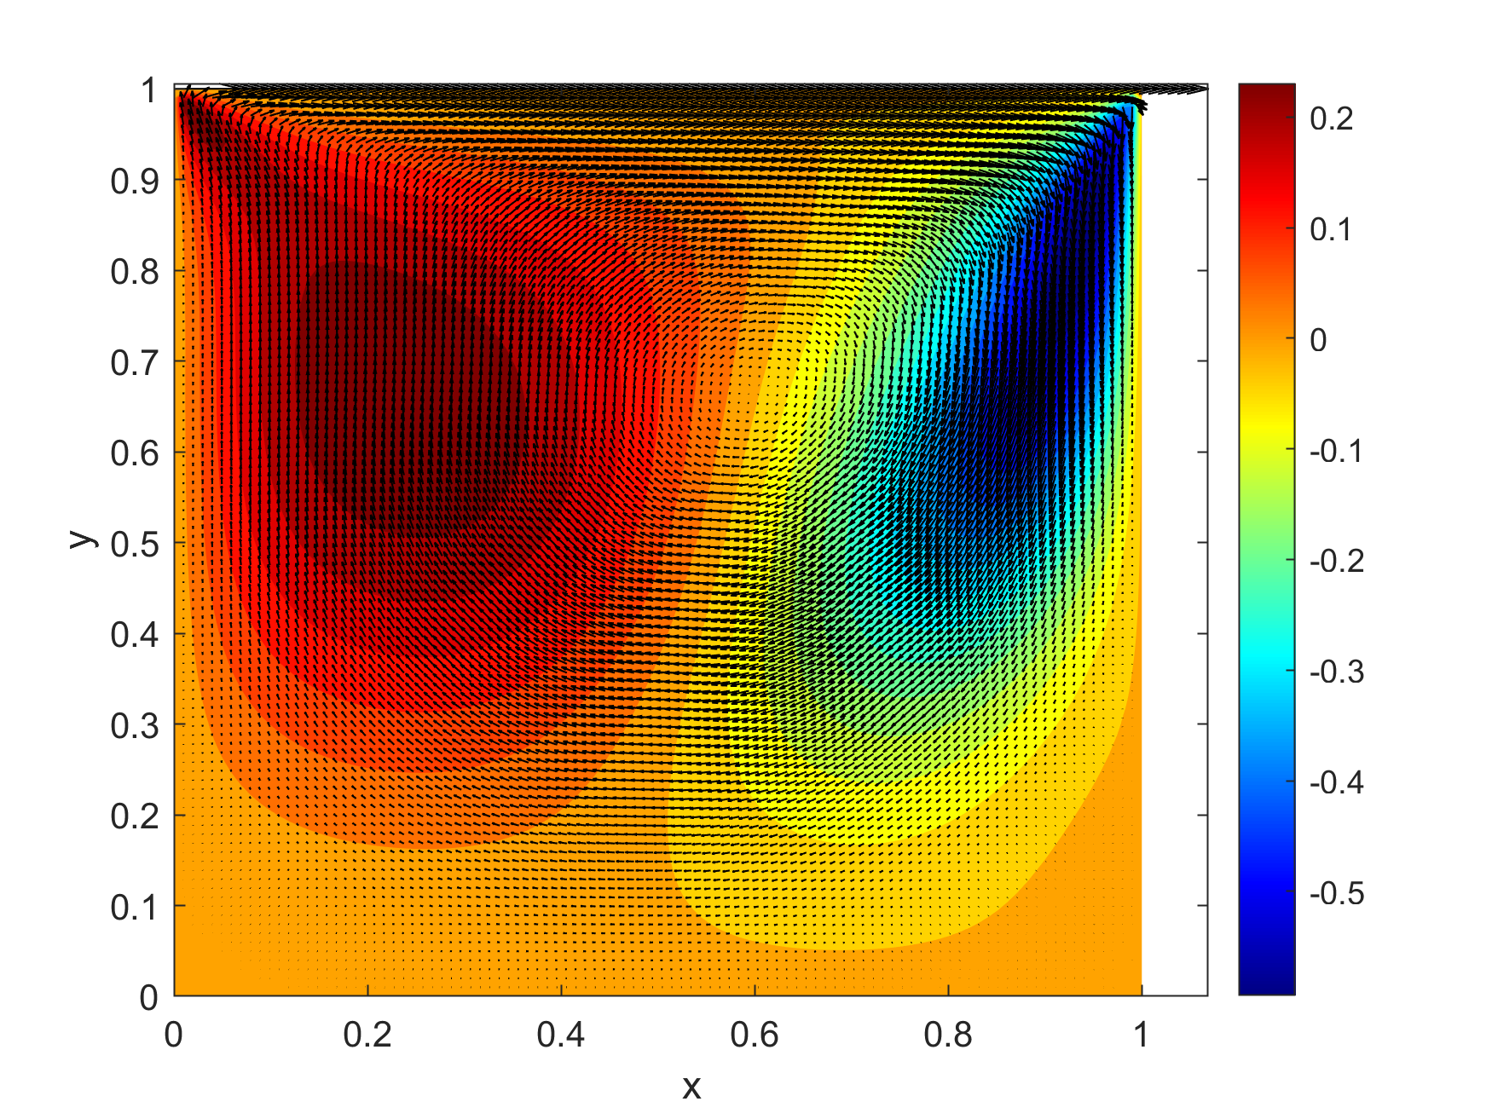
VISUALIZATION
CONTOUR PLOT OF v-VELOCITY(Re=200,102x102)

Slide 39
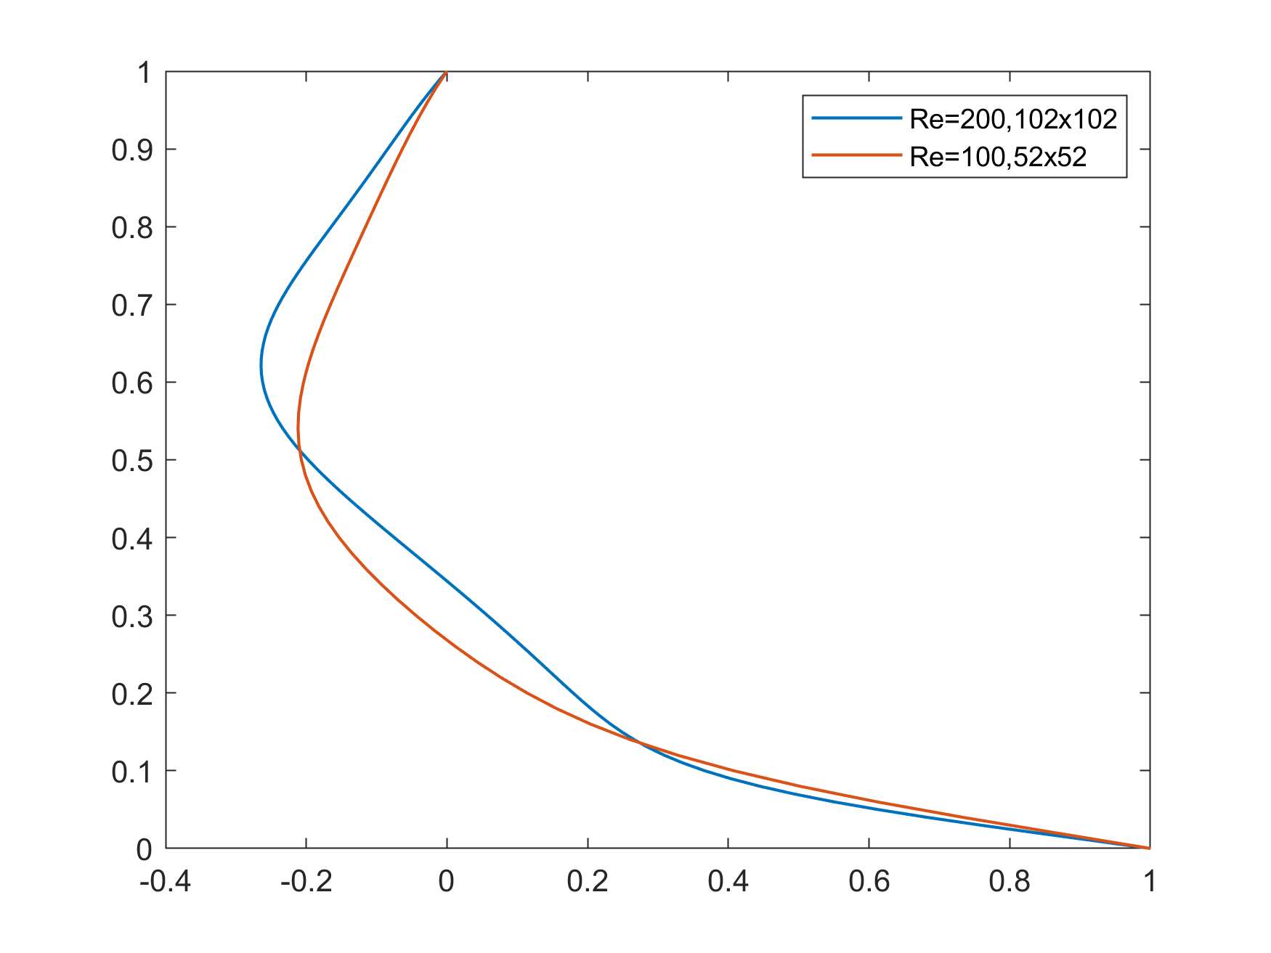
CENTRELINE PLOT

Slide 40
REFERENCES
1)http://panoramix.ift.uni.wroc.pl/maq (Research paper)
2)Numerical heat transfer and fluid flow, Suhas V Patankar
3)Introduction to computational fluid dynamics, HK Versteeg & W Malalasekera
4) https://www.youtube.com/watch?v=24JWBf7d8ic (Pressure correction techniques)
5) College resource(PPT)

